Slide 1
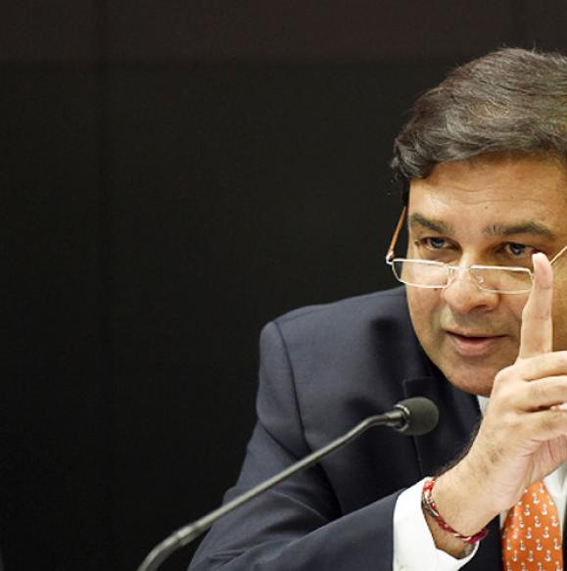
Monetary Policy: Tools
Quantitative/Gen./Indirect
Qualitative: Selective, Direct
Ratios: SLR, CRR & Incremental CRR
Margin / LTV
OMO & MSS
Rates: Bank, MSF, LAF [Repo, RR]
Consumer Credit control / EMI
Credit Rationing /PSL
Moral Suasion
Direct Action
Review of last one year’s Monetary policies.

Slide 2


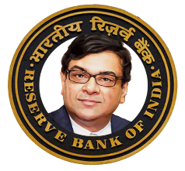




Bank Rate: Meaning? [as such defined in RBI act but..]
Long term Loan
Interest rate: 6.75%
BANK RATE
Bank rate not the main tool of m.policy but,
If CRR/SLR not maintained
penalty-: bank rate+3 or 5%
Depending on repeat offense
Collateral: Nothing
REF: http://profit.ndtv.com/news/corporates/article-repo-rate-and-other-terms-explained-302105

Slide 3
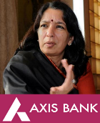




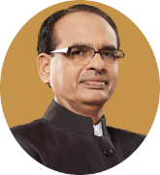

Liquidity adjustment facility (LAF): Repo Rate: WEF 2000,
Repo Rate 6.25%
100 crore
client to Repurchase
@106.25 Cr.
Overnight (1 day),
7 days, 14 days
Collateral: G-Sec
But not from SLR
All clients eligible
Repo rate: rate @which clients borrow short term funds from RBI, using G-sec as collateral.

Slide 4


Marginal Standing Facility: Meaning? [WEF 2011, May]
MSF: 6.75%
100 crore
SCB to Repurchase
@106.75 Cr.
After 1 day..
Friday 3 days
Collateral:
G-Sec
Even from SLR
MSF= Repo +1% +0.5%
(WEF Apr.2016)
Only SCB eligible
Notes:
Usually overnight.

Slide 5
What’re the differences between Repo vs MSF?
Term
Who?
Govts; Banks, Non-Banks
Only SCB MINUS RRB
Collaterals?
Banks can’t use SLR quota
Can use, with caveats**
LAF-REPO
MSF
Father?
Narshiman-II (98)-> 2000
2011; for emergency,
Min.
5 cr.
1 cr.;
Notes:
https://www.rbi.org.in/scripts/NotificationUser.aspx?Id=6394&Mode=0
LAF open daily except Saturday.

Slide 6
Net demand and time liability (NDTL)
NDTL
+100 Cr.
CRR
-4 Cr.
SLR (G.Sec)
-20.50 cr.
LEFT
75.5 cr.
Addl G-Sec
5.5 cr.
Lending
70 cr.
Can pledge these, to borrow via MSF..Yet, won’t be fined for SLR-default under Banking regulation Act.
but max. 1% of NDTL= 1 cr. & interest rate 0.50%higher
Can pledge this, to borrow via
LAF-Repo window @6.25%

Slide 7

LAF Reverse Repo Rate: Meaning?
Reverse Repo Rate 5.75%
100 crore
RBI to Repurchase
@105.75 Cr.
After 1|7|14 days
“it is interest rate paid by RBI to its clients for short term loans.” all clients eligible. RR = R% -1% nahi 0.5%

Slide 8
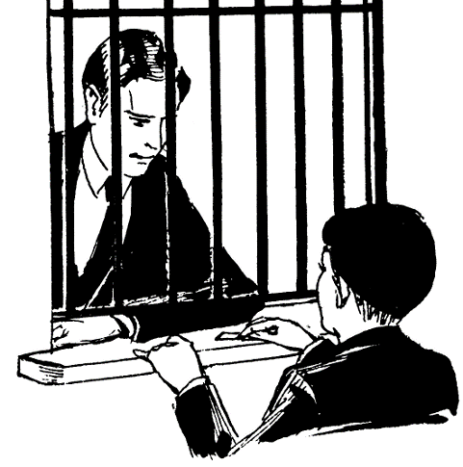
E-kuber (online) “Window” and instruments
OMO
G-Sec
T-Bills-upto 364 days
MSS’04
G-sec (upto 2 years)
T-bill-upto 364 days
LAF’2000
Repo-SLR securities
MSF’2011
Repo: inject Liquidity
RR: Suck liquidity
CMB’90 days
Sell: Suck liquidity
Inject liquidity
Buy: Inject liquidity
Sell: Suck liquidity
Fight Deflation
Inject Liquidity
Fight Inflation
Suck liquidity

Slide 9
Policy corridor = 0.5%; earlier it was 1% (or 100 basis points)
Reverse Repo (2000)
MSF (2011)
+0.50%
Repo (2000)
6.25%
-0.50%
Liquidity Adjustment Facility (LAF) window
Bank rate is independent…but =rate MSF(usually)
Policy Rate = Repo Rate.
1%= 100 basis points
6.5%- decreased by 25 basis points
6.25= latest repo rate.

Slide 10
Why policy corridor narrowed?
M.Policy
a narrower corridor will ensure a “finer alignment of the weighted average call rate (WACR) with the repo rate.” [call rate = inter bank borrowing, mainly to meet CRR requirement.]
ensure that durable liquidity in the system.
Aid in policy transmission.

Slide 11


Since Repo rate is our Policy rate…let’s focus
Repo Rate 6%
Car Loan 12%
1 lakh
Repo Rate 18%
Car Loan 36%
Demand ▼
So reduce MRP 70k to attract customers
Combat inflation:
▼money supply /▲interest rates to curb demand

Slide 12


Repo Rate and money supply
Asset
Liability
Repo Loans to Banks
M0: reserve money
High powered money
Money
Multiplier
Asset
Reserve: 10
Liability
Deposit: 100
Loan: 90+..
Repo:__
Currency with public
M1: Currency with Public + Demand Deposits

Slide 13
Monetary Policy: Quantitative, General, indirect Tools
Combat
CRR/SLR
▼
Inflation
Deflation
Money?
Tight / Dear
Easy / Cheap
▲
Policy Rate (Repo Rate)
▲ (hike)
▼
OMO|MSS*
Sell
Buy
Money supply
▼
▲

Slide 14
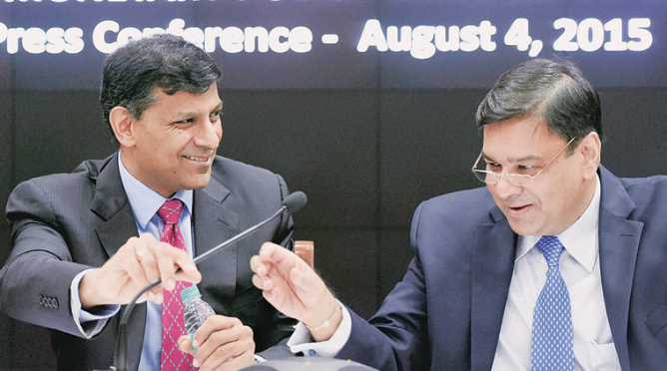
Monetary Policy: Tools
Quantitative/Gen./Indirect
Qualitative: Selective, Direct
Reserve Ratios (CRR, SLR)
Margin / LTV
OMO & MSS
Rates: Bank, MSF, LAF [Repo, RR]
Consumer Credit control / EMI
Selective Credit Control (SCC), Credit ceiling & Rationing, PSL
Moral Suasion & Direct Action
Next: Review of last year’s Policies
अब तुम्हारे हवाले वतन साथियो!

